Slide 1


Defining competence to do a skills gap analysis

Slide 2
Long Form A- Section 10
10.3 Describe how their competency has been assessed and demonstrate they are suitable for the roles and its responsibilities. Consider their CPD, professional qualifications and any ongoing development
10.10 You must provide a copy of the Induction Programme where applicable. (N/A if an existing employee)
10.11 You must provide a copy of the skills gap analysis detailing any learning and development plans
The skills gap analysis and learning and development plan can be combined, as long as all the required information is provided. This must include
Specific skills and competencies related to the role and how the candidate scores against these
Details of any planned or recent training, to address any gaps – include details of training provider, the length of the course and the date of completion
The name of the person who has oversight of the candidate’s training
We expect these documents to be in a table or chart

Slide 3

Competent Employees Rule
TC 1.1.4
In this sourcebook, competence means having the skills, knowledge and expertise needed to discharge the responsibilities of an employee’s role. This includes achieving a good standard of ethical behaviour

Slide 4
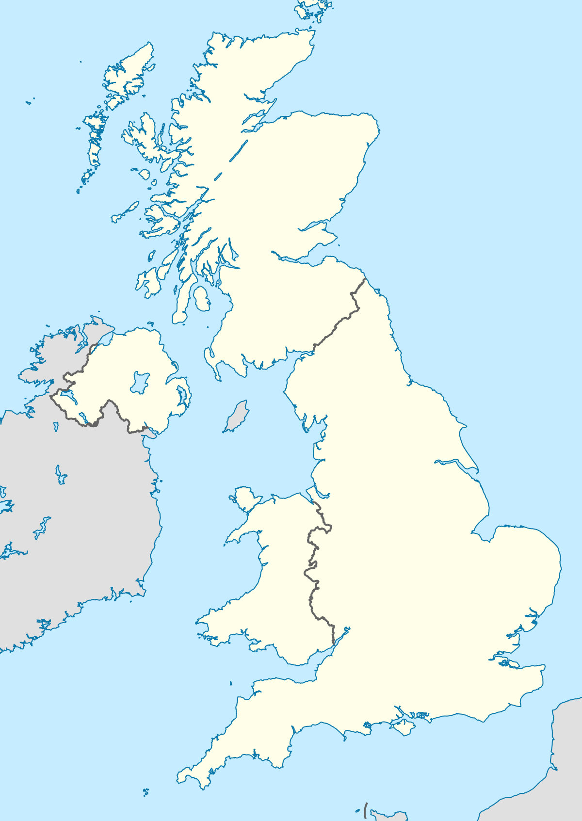
Background
You have booked a driver to take members of your family (wife/husband or kids) from home to a destination 500 miles away, across the UK
It is mid winter and snow is forecast
The driver has arranged to pick your passengers up early to take full advantage of the day light hours but the first and last part of the journey will be completed in darkness
The destination is 10 miles from the nearest ‘A Road’ and the last mile is an off-road track
The route will make use of as many motorways as possible but do not cover at least 25% of the way.

Slide 5

The day of the journey
It is 5.30 am
The weather outside is below freezing and it is foggy
The door bell rings
You answer the door to be greeted by a young man who is complaining that he only had a few hours sleep. He turns out to be your driver.
To add to your concerns the driver divulges that he had only passed his driving test last week on the third attempt

Slide 6

The Driver Challenge
Do you let your family travel with the driver?
What were the points that you considered in coming to your decision?

Slide 7


Slide 8

Main concerns
Experience
Professionalism
Weather conditions

Slide 9

Our expectations
Level of relevant experience
Track record of satisfaction
Professional image
Appropriate vehicle serviced, cleaned and ready
Route planned with refreshment breaks
Driver alert and ready

Slide 10
How high do you set the competence bar?

Slide 11
How high do you set the competence bar?
Safely transport customers throughout the UK
Minimum 100 hours experience
Minimum 4.0 customer rating
Professional image
Appropriate vehicle serviced, cleaned and ready
Route planned with refreshment breaks
Driver alert and ready

Slide 12
How high do you set the competence bar?
Professional Excellence
Advanced Driver, Defensive Driving, Off Road Driving, Skid Pan qualification
500 hours incident free driving
Minimum 4.75 customer satisfaction
Continental driving approved
Safely transport customers throughout the UK
Minimum 100 hours experience
Minimum 4.0 customer rating
Professional image
Appropriate vehicle serviced, cleaned and ready
Route planned with refreshment breaks
Driver alert and ready

Slide 13
How high do you set the competence bar for a financial adviser?
Professional Excellence
Chartered Status
Complex cases
Mentor
Lowest risk rating
Error free advice and documentation
No upheld complaints
Minimum 100 hours CPD
KPIs meet levels required
Achieve or exceed performance objectives

Slide 14
How high do you set the competence bar for a financial adviser?
Professional Excellence
Chartered Status
Complex cases
Mentor
Lowest risk rating
Error free advice and documentation
No upheld complaints
Minimum 100 hours CPD
KPIs meet levels required
Achieve or exceed performance objectives
L4 qualification
100% accuracy advice
80% first time passes for documentation
No more than 2 upheld complaints
KPIs within tolerances

Slide 15

Role/Gap analysis – start with job description
The need for consistency – templates
All relevant content included – benchmarking
Irrelevant content removed – evidencing (TC/CER covers all)
The benefit of competency frameworks – understanding of what is expected
Reliable base for assessment – standardised approach

Slide 16
Template
Purpose of the role
Key responsibilities – the whats
Experience
Education & Qualifications)
Skills ) the hows
Competencies )

Slide 17
Benchmarking
Have you covered everything that should be included? External benchmarking sources
External job descriptions
National Apprenticeships

Slide 18
National
Apprenticeship
Standards - Mortgage Adviser
Overview of the role
Giving clients advice on appropriate mortgages and related protection products such as life insurance or sickness and unemployment insurance.
Details of standard
The Mortgage Advice Market
Mortgage advice is provided by a number of different types of businesses; direct to consumer through banks & building societies and also via mortgage intermediaries in the form of independent brokers or advisers linked to an Estate Agent or New Homes Developer. Due to changes in regulation, including the ‘Mortgage Market Review’, the role of the Mortgage Adviser has become more technical, with increased regulatory requirements and has led to an increase in demand for qualified practitioners in the sector.
The Role
The role of a qualified mortgage adviser is to identify and satisfy customer mortgage requirements and associated protection needs, through fully compliant regulated meetings. These meetings can take place in a variety of environments, depending on the type of employer including face to face (either in business premises or in a customer’s home) or over the telephone. In addition to giving advice on appropriate mortgage products, the mortgage adviser also advises on related protection products including life assurance, critical illness, accident, sickness and unemployment, income protection and buildings and contents insurance.
This apprenticeship offers an ideal entry point for a career in the mortgage advice sector or for potential progression into other Financial Services roles and can attract candidates from various backgrounds with differing skills and experience.

Slide 19
Irrelevant content removed
Why was the responsibility included in the first place?
If not relevant it must be amended or removed – even if it requires the job to be re-evaluated
All responsibilities within the job description must be evidenced to comply with TC/CER requirements

Slide 20
Competency Frameworks
A means by which firms communicate which behaviours are required, valued, recognised and rewarded with respect to specific organisation roles
Different models and approaches available. Often depends on the size and shape of the business and available resources.
Firms need to share their behavioural expectations of the chosen competencies to help ensure consistent understanding and assessment

Slide 21
Common Competencies – Firms could have a number of these but target ones for specific roles
Integrity
Responsibility
Teamwork
Communication
Customer Focus
Personal Development
Business results
Planning / Organising
Decision Making
Problem Solving
Leadership
Adaptability

Slide 22
Reliable base for assessment
Clearer standards help deliver more consistent assessments
Assessors and people being assessed understand what is expected
This approach satisfies 2 of the 3 rules of assessment – Transparency and Reliability

Slide 23
Role Analysis
OUTPUTS/OUTCOMES
Knowledge | Skills | Competencies | Values/CoCON

Slide 24
Mortgage Adviser Role – Key responsibilities
Meeting performance targets
Ability to prospect and organise meetings
Fact-find effectively to establish the client’s current finances and future aspirations.
Provide high quality professional independent mortgage advice and explain different types of mortgages available
Explain required insurance products so that clients can make informed choices.
Communicate with estate agents, mortgage lenders, solicitors and insurance providers.
Ensure all regulatory documentation completed within the required timescale
Attend monthly results meeting and present results in all targeted areas to your Sales Manager
Maintain Generic knowledge of the financial services industry and knowledge that is deemed necessary

Slide 25
Role Analysis
OUTPUTS/OUTCOMES
Generate meetings | Provide advice | Complete documentation | Create and submit business reports
Manage appointment diary | Write client reports | Update records | Complete CPD
Conduct fact finds | Handle communication with parties
Knowledge | Skills | Competencies | Values/CoCON

Slide 26
Values
How we conduct our business is just as important as what we do. Our core values are the principles that guide us daily in helping our customers achieve financial prosperity and peace of mind. At all times, we strive to distinguish our company as an admired financial services leader and trusted brand that is differentiated by top talent and innovative solutions for all stages of life.
Worthy of Trust: We keep our promises and are committed to doing business the right way.
Customer Focused: We provide quality products and services that meet our customers' needs.
Respect for Each Other: We are inclusive and collaborative, and individuals with diverse backgrounds and talents can contribute and grow.
Winning with Integrity: We are passionate about becoming the unrivaled industry leader by achieving superior results for our customers, shareholders, and communities.

Slide 27
Role Analysis
OUTPUTS/OUTCOMES
Generate meetings | Provide advice | Complete documentation | Create and submit business reports
Manage appointment diary | Write client reports | Update records | Complete CPD
Conduct fact finds | Handle communication with parties
Knowledge | Skills | Competencies | Values/CoCON
 |  |  | Worthy of Trust
 |  |  | Customer Focused
 |  |  | Respect for Each Other
 |  |  | Winning with Integrity
 |  |  | Integrity
 |  |  | Due Care
 |  |  | Open with Regulators
 |  |  | Good consumer outcomes
 |  |  | Market Conduct
 |  |  | 3 Cross cutting rules

Slide 28
Knowledge, Skills and Behaviours
Knowledge
CeMAP qualification
Skills
Problem solving
Time Management
Competencies
Communication Skills
Integrity
Customer Focus
Personal Development

Slide 29

Skills or Competencies?
Skill typically relates to a single proficiency
Competencies often encompass a group of related strengths
Skills are gained through training and experience
Skills can be hard or soft
Soft skills are non technical and can apply to a broad range of roles –e.g. interpersonal skills. Hard skills are technical abilities need to perform your role – coding, marketing analytics, graphic design
Competencies typically combine skills, abilities and knowledge and specific behaviours to succeed in role

Slide 30
Role Analysis
OUTPUTS/OUTCOMES
Generate meetings | Provide advice | Complete documentation | Create and submit business reports
Manage appointment diary | Write client reports | Update records | Complete CPD
Conduct fact finds | Handle communication with parties
Knowledge | Skills | Competencies | Values/CoCON
CeMAP | Problem solving | Communication | Worthy of Trust
Products | Time management | Customer Focus | Customer Focused
Advice Process | Planning | Integrity | Respect for Each Other
Documentation requirements |  | Personal Development | Winning with Integrity
Record keeping requirements |  | Adaptability | Integrity
 |  | Teamwork | Due Care
 |  |  | Open with Regulators
 |  |  | Good consumer outcomes
 |  |  | Market Conduct
 |  |  | 3 Cross cutting rules

Slide 31
Role Analysis
OUTPUTS/OUTCOMES
Generate meetings | Provide advice | Complete documentation | Create and submit business reports
Manage appointment diary | Write client reports | Update records | Complete CPD
Conduct fact finds | Handle communication with parties
Knowledge | Skills | Competencies | Values/CoCON
CeMAP | Problem solving | Communication | Worthy of Trust
Products | Time management | Customer Focus | Customer Focused
Advice Process | Planning | Integrity | Respect for Each Other
Documentation requirements |  | Personal Development | Winning with Integrity
Record keeping requirements |  | Adaptability | Integrity
 |  | Teamwork | Due Care
 |  |  | Open with Regulators
 |  |  | Good consumer outcomes
 |  |  | Market Conduct
 |  |  | 3 Cross cutting rules

Slide 32
What good looks like
Output/Outcome | competence standards | sources of evidence | skills/behaviours that might be evidenced | Values that might be evidenced
Generate meetings | As per checklist ( May need to design one) | Checklist, KPIs | Communication Planning | Respectful Supportive
Manage appointment diary | Enter appointments within 1 hour Update changes within 1 hour | Appointment Diary, KPIs | Planning
Conduct fact finds | Conduct Fact Finds in accordance with Company Process | Monitoring checklist, KPIs, Quality Assurance Checks, Customer Feedback Role Plays Observations | Communication Planning Integrity | Respectful Supportive
Provide advice | Provide advice in accordance with Company Process across a range of mortgage products | Monitoring checklist, KPIs, Quality Assurance Checks, Customer Feedback Knowledge tests Role plays Observations | Communication Planning Problem solving Adaptability Teamwork | Respectful Supportive Dynamic Connected

Slide 33
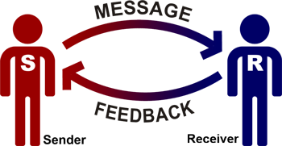
Communication
Visuals used are visually stimulating
Speaks audibly
Completes all sentences during presentations
Avoids 'pet' words and phrases ( you know, I mean to say)
Assumes a confident, positive posture when delivering presentations
Appropriately attired for presentations made
Handles questions raised by the audience in a confident manner
Keep customers informed of developments from which they might benefit
Challenge and question to ensure that you fully understand how a contract works
Check customers understanding where possible and practical to do so
Proactively seek suggestions from your customers on how you might improve
Adapt your approach to suit your customers
Ensures that all team members are treated fairly
Keeps team members abreast of individual progress
Gives an accurate picture of the situation clearly and concisely

Slide 34
From Role Analysis to Competence
Evidence Gathered – identifies gaps to be closed- The GAP ANALYSIS
Role Analysis
Each element supported by appropriately detailed standards to help ensure consistency of application
Portfolio of evidence completed – competence achieved.
No gaps
Development Plan in place to close gaps sufficiently for competence to be considered
Financial Soundness

