Slide 1


T&C Reviews
How to design and undertake a review of your T&C scheme

Slide 2
Introductions
Your experiences of writing a T&C scheme
Have you been involved in reviewing a T&C scheme?
Personal objectives for today?

Slide 3
Outcomes
To know what a T&C scheme comprises
To identify the triggers of a T&C scheme review
To set the objectives of a T&C Review
To determine the standards and measures used during the review
To identify the sources of evidence to be used
To conduct a review
To structure your review report and ratings
To present your report
To facilitate action planning

Slide 4

What is a T&C Scheme?
How does it differ from T&C Procedures?

Slide 5
T&C Scheme
Procedures
All supporting forms, courses, systems, MI reports, role descriptions, policies, processes, procedures and activities with all supporting records.
Essentially it is everything that is brought together to bring the T&C Procedures to life

Slide 6

Why undertake a review now?

Slide 7
Triggers of a review
Part of a regular cycle documented into the scheme
Business concerns
Findings from Compliance Monitoring
Feedback from users
Changes in legislation or regulation
Change of scheme ‘owner’
Follow up to previous review
Scheme has become outdated

Slide 8
Applying Assessment Process ORCE

Slide 9
Assessment Process
O
R
C
E

Slide 10
Assessment Process
OBJECTIVES
R
C
E

Slide 11
Purpose of the review
Agree and set the objectives
1
Shape the scope of the review
2
Decide a desk top or full review
3
Agree the standards to be used to measure success. It makes it easier to agree findings.
4

Slide 12
Desk Top or Full Review?
DESK TOP | FULL
Quicker – based on what should happen | Checks understanding
Consumes less resource | Measures what happens in reality
 | More resources used – (e.g. interviews)
 | Establishes consistency of application

Slide 13
Thematic of Full Review
Supervision
CPD
Induction
Competence
FIT and Proper practices
Possible improvements

Slide 14

Objectives set – time to gather evidence

Slide 15
Assessment Process
OBJECTIVES
RECORD
C
E

Slide 16

Possible sources of evidence
Name as many as you can

Slide 17
Possible sources of evidence
Scheme Procedures
Observation Aids
1-2-1 Forms
Development Plan
CPD Records
MI Reports
Competence Assessments
Training Material
Supporting policies, processes and procedures
Testing tools
Certification documentation

Slide 18
What about interviews?
Who might you wish to interview?

Slide 19
What about interviews?
SMF
T&C Manager
Training Consultants
Compliance Manager
Compliance Monitoring Consultant
1st line supervisor
2nd Line Supervisor
Adviser Trainee
Adviser Newly Competent
Experienced Adviser

Slide 20
Structure of interviews
Create core questions shaped on review of procedures and/or records
Remember rule of 3 to seek consistency

Slide 21
We have our evidence – now what?

Slide 22
Assessment Process
OBJECTIVES
RECORD
CLASSIFY
E

Slide 23

Standards – Let’s start with TC

Slide 24
We need standards to be used
Possible sources?

Slide 25
Content of TC Sourcebook – 36 Rules
Scope
Assessment of competence and supervision
Knowledge and Competence requirements before starting MCD activities
Qualification requirements
Training Needs
Maintaining competence
CPD
Statements of Professional Standing
Notification requirements
Time limits
Record keeping
MiFID requirements
IDD requirements
Appropriate qualifications/Accredited bodies

Slide 26
TC Sourcebook Reference | Topic
TC1.1.1 | Who and what
TC1.1..1 | Application to MiFID and IDD
TC1.1.B | ESMA knowledge & competence guidance
TC1.1.2 | Where
TC1.1.3 | Purpose
TC1.1.4 | Meaning of competence
TC1.2.1 | Actions for damages
TC2.1.1 | Assessment of competence and supervision
TC2.1.2 | Need for appropriate supervision
TC2.1.3 | Criteria for competence and how supervision is determined
TC2.1.4 | Supervisor skills and qualifications
TC2.1.5 | Retail Investment Products supervision
TC2.1.5A-F | MiFID requirements
TC2.1.5G-I | P2P requirements
TC2.1.6 | Qualification before starting regulatory activity
TC2.1.7 | Requirements for full qualifications for specific activities
TC2.1.8A | Qualification for retail investment adviser deemed competent at 30/9/2009
TC2.1.9 | Exemption from appropriate qualification requirements
TC2.1.10 | Selection of appropriate qualification
TC2.10A | FCA requirements for qualification providers
TC2.10B | Guidance for Accredited Bodies
TC2.1.11 | Training needs and evaluation

Slide 27
TC2.1.12 | Competence reviews
TC2.1.13 | Maintain competence
TC2.1.14 | Establish and maintain a T&C scheme
TC2.1.15 | CPD hours Retail Investment Adviser
TC2.1.16 | CPD structured hours Retail Investment Adviser
TC2.1.17 | Suspension of CPD hours Retail Investment Adviser
TC2.1.18 | Family member definition for CPD suspension
TC2.1.19 | Suspension of CPD criteria Retail Investment Adviser
TC2.1.20 | Types of structured CPD
TC2.1.21 | Types of unstructured CPD
TC2.1.22 | CPD requirements Retail Investment Adviser
TC2.1.23 | CPD relevance Retail Investment Adviser
TC2.1.23A-C | CPD for pension transfer specialist
TC2.1.23D-J | CPD for funeral plans
TC2.1.24 | CPD Record Keeping
TC2.1.25 | CPD records access
TC2.1.26 | Annual declarations Retail Investment Adviser
TC2.1.27 | Independent Verification - Retail Investment Advisers
TC2.1.28 | Independent Verification - Who- Retail Investment Advisers
TC2.1.29 | SPS - Retail Investment Adviser
TC2.1.30 | Accredited Bodies -Retail Investment Advisers
TC2.1.31 | Notification requirements
TC2.1.32 | Notification requirements - significance
TC2.1.33 | Notification form
TC2.2A1 | Time limits appropriate qualification
TC2.2A.2 | Calculation of 30 months
TC2.2A.3 | Failure to get qualifications within timescale

Slide 28
TC2.2A.4 | Failure policy
TC2.2A.5 | Examinations for overseers
TC2.2A.6 | Record keeping for qualifications
TC3.1.1 | Records to be kept
TC4.1 1-6 | Specific requirements for MiFID firms
TC4.2 1-7 | Specific requirements for IDD
TC App 1.1.1 | Activities in scope
TC App 2.1.1 | Territorial scope
TC App 3.1.1 | Circumstances when TC does not apply
TC App 4.1.1 | Appropriate qualification tables
TC App 5.1.1 | Assessment criteria for qualification provider
TC App 6.1.1 | Accredited Bodies
TC App 7.1.1 | Guidelines for gap fill
TC App 8.1.1 | Professional standards submission
TC TP1-TC TP8 | Transitional Provisions
TC Sch 1-6 | Additional provisions

Slide 29

Key Performance Indicators
What does the TC Sourcebook specifically say about KPIs?

Slide 30

TC Sourcebook - KPIs
Zero
Nothing
No mention of Management Information

Slide 31
In the beginning there was the FSA Healthcheck
50 questions
Responsibility
The Scheme
Recruitment
Training
Attaining Competence
Examinations
Maintaining Competence
Supervising
Monitoring
Record Keeping

Slide 32
The FSA Healthcheck did ask
What Management Information is in place, how do you know it is robust, how often is it reviewed and by whom?

Slide 33

So how about the FSP standards?

Slide 34
What about the FSP standards?
Defining Key Performance Indicators
KPIs are used to monitor actual performance against key measures to provide those responsible for individual and business performance with a current picture of progress against customer and business objectives, competence standards and quality of outputs.
Xref TC Sourcebook (Next slide)

Slide 35
TC Sourcebook
A firm must not allow an employee to carry on an activity in TC Appendix 1 without appropriate supervision.
Firms should ensure that employees are appropriately supervised at all times. It is expected that the level and intensity of that supervision will be significantly greater in the period before the firm has assessed the employee as competent, than after. A firm should therefore have clear criteria and procedures relating to the specific point at which the employee is assessed as competent in order to be able to demonstrate when and why a reduced level of supervision may be considered appropriate. At all stages firms should consider the level of relevant experience of an employee when determining the level of supervision required.

Slide 36
KPI Outcomes
Outcome Standards
Performance measures at an overall business level are defined by the Senior Managers
KPIs are framed to drive the desired quality and standards as well as the quantity performance measures
Measures specific to the expected customer outcomes form part of the KPI framework
Individuals’ KPIs are appropriate to their role
Guidance is provided from Senior Managers on how they measure achievement of KPIs and this is adopted consistently at all levels
Reviewing and reporting against KPIs is sufficiently frequent to be effective in measuring and monitoring performance
The KPI report always triggers the appropriate supervisor action or response to negative trends or failure in any area
Individual performance is reviewed with the role holder against the KPI data held and further coaching, training or assessment is agreed as appropriate to the findings
Timely follow up takes place to ensure the actions are carried out effectively and produce the required outcome.

Slide 37
KPI Guidance
How are the firm’s Key Performance Indicators (KPIs) decided? KPIs should be shaped to reflect the customer and business outcomes to be achieved by the team, function or business. The KPIs should support fully the TCF outcomes and help to embed the expected behaviours towards customers in the business. For small businesses this may be set out in the business plan if this includes the appropriate targets and measures.
Does the firm apply any differentiating KPIs relative to specific roles? For roles which carry a higher risk there should be additional detailed and comprehensive KPIs applied. It should be clear from the job or role profile what the scope of the role includes and the risks associated with it.
Examples of high risk roles would include derivatives traders, deal makers, and pension transfer specialists.
For retail advice roles KPIs would normally include:
– Product and business mix
– Product provider mix/bias (independent or
multi tie firms)
– Persistency and cancellations
– Complaints
– Regulatory standards
– File checks/reject rates
– Activity levels
– Sales performance
– Fact find completions and conversion rates
– Execution only sales
– Results from customer surveys, feedback
and mystery shopping outputs
Reporting should use the most appropriate format. This could be a traffic light review (RAG status) or specifically detail performance against each measure.

Slide 38
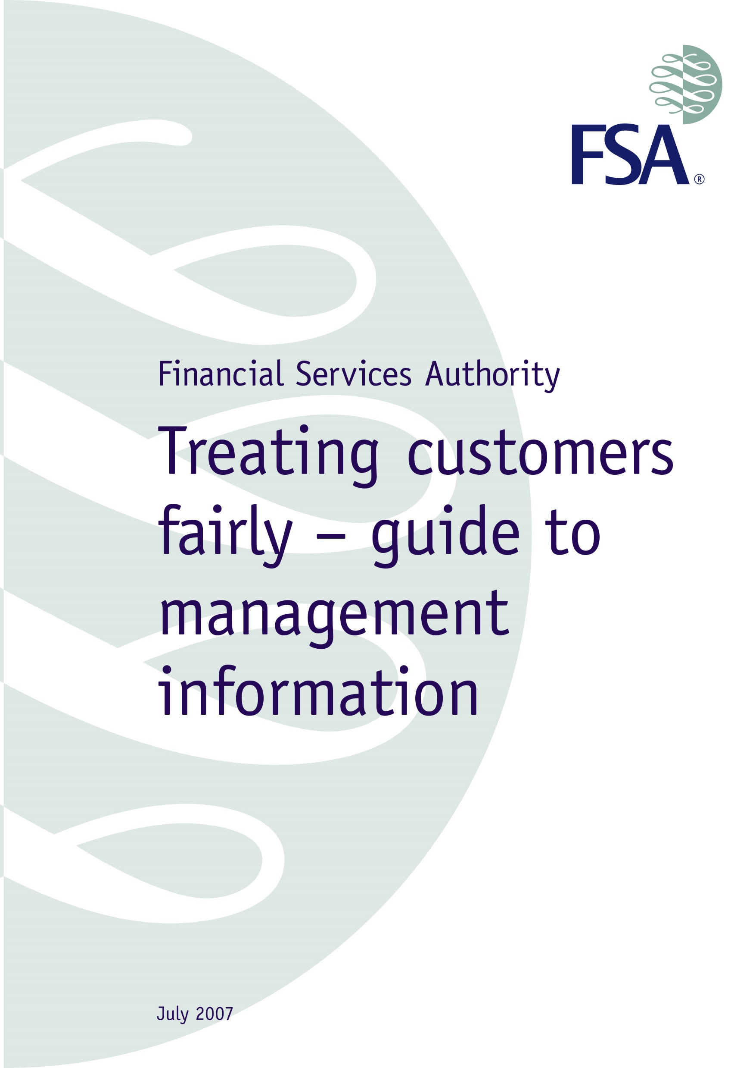
Back to the FCA – Management Information

Slide 39
FCA Guidance States
Using TCF MI should include the following five steps, so that the MI is:
• seen – an appropriate level of management receives, understands and reviews the MI;
• challenged – anomalous or unexpected results are challenged;
•analysed and monitored – the right messages and conclusions are drawn from the data;
• acted on – where appropriate, actions are taken to remedy the situation, to investigate further and to follow up on those actions; and
• recorded – records are made of what is done and information is subsequently gathered to enable the success of those actions to be assessed.

Slide 40
Main People Risks
People only perform when observed
Poor Analysis or no analysis undertaken
Vested interest in the outcome
Resistance to change
Managers pay lip service
People don’t know what they are doing

Slide 41
People Risks
Poor Analysis or No Analysis Undertaken
Define what you need to know
Allocate responsibilities
Formalise process
Communication between departments
Adequate training to interpret

Slide 42
8 Principles can be used too
Competence
Recruitment
Training
Assessing Competence
Supervision
Qualifications & Tests
Reporting & Controls
Record Keeping
Supported by 74 indicators

Slide 43
8 Competence Principles - Supervision
Through effective supervision performance gaps and/or risks are identified and addressed.
33. The focus of supervision is on the effectiveness of the supervisory invention
34. Supervisors must be competent to perform their role
35. Supervision is appropriate to the possible risks identified in achieving the desired outcomes.
36. Supervision is based on a continuum ranging from 100% to minimum benchmark levels. The criteria used to apply this supervisory continuum are clear.
37. Key performance measures are defined and measured against key job outputs.
38. Any assessments are performed by people that do not have a vested interest in the outcome. If they do appropriate measures are in place to sample the appropriate application of the assessment decisions

Slide 44
Key performance indicators
Quantitative indicators that can be presented with a number.
Qualitative indicators that can't be presented as a number.
Leading indicators that can predict the outcome of a process
Lagging indicators that present the success or failure post hoc
Input indicators that measure the amount of resources consumed during the generation of the outcome
Process indicators that represent the efficiency or the productivity of the process
Output indicators that reflect the outcome or results of the process activities
Practical indicators that interface with existing firm processes.
Directional indicators specifying whether or not a firm is getting better.
Actionable indicators are sufficiently in a firm's control to effect change.
Financial indicators used in performance measurement

Slide 45
We’ve classified our evidence – what’s next?

Slide 46
Assessment Process
OBJECTIVES
RECORD
CLASSIFY
EVALUATE

Slide 47

We need to decide whether the agreed standards have been met
Pass/Fail approach?
RAG system?
Rate by Indicator?

Slide 48

RAG ratings possible definitions
Red - Unacceptable, immediate action required
Amber - Acceptable, further action recommended to strengthen arrangements
Green - Satisfactory, no further action required

Slide 49
Next is your report
Executive summary
Next steps expected of readers
Overview by section
Breakdown within section by indicator
You do not make recommendations at this stage
Aim to agree content of report (Not resolutions) before it becomes a discoverable document

Slide 50
Report Presentation
Circulate agreed report
Supplement with a structured presentation
Agree actions for people to take next steps to address RED/AMBER areas. Ensure responsibilities, timelines and review dates are agreed

